Slide 1

“An Overview of Research Papers Analysis Regarding Road Scene Analysis”
Supervisor : Md. Tamim Hossain
Presented By : Amita Das Falgunee

Slide 2

Studied Papers & Identified Categories
OBJECT DETECTION & TRACKING (Helmet, Vehicles, Pedestrians, Obstacles)
ROAD SCENE UNDERSTANDING (Road Surface, Lane Counting, Road Type, Weather)
TRAFFIC ANALYSIS & DENSITY ESTIMATION
CONNECTIVITY & IoV (Internet of Vehicles)
2

Slide 3
Identified Patterns
Input (Video/Image)
Preprocessing (Noise reduction, enhancement)
Feature Extraction (Edges, colors, motion, etc.)
Detection/Segmentation (Objects, road, obstacles)
Analysis/Classification (What is it? Where?)
Decision/Warning (Action to take)
Output (Visual/Audio alert, classification)
2

Slide 4
Category 1: OBJECT DETECTION & TRACKING (Helmet, Vehicles, Pedestrians, Obstacles)
Key Insights and Findings:
Vehicle detection & tracking
Pedestrian / bicycle / obstacle detection
Accident / risk detection
Motion estimation
Real-time object localization
Instance segmentation (precise object boundary extraction)
2
3

Slide 5
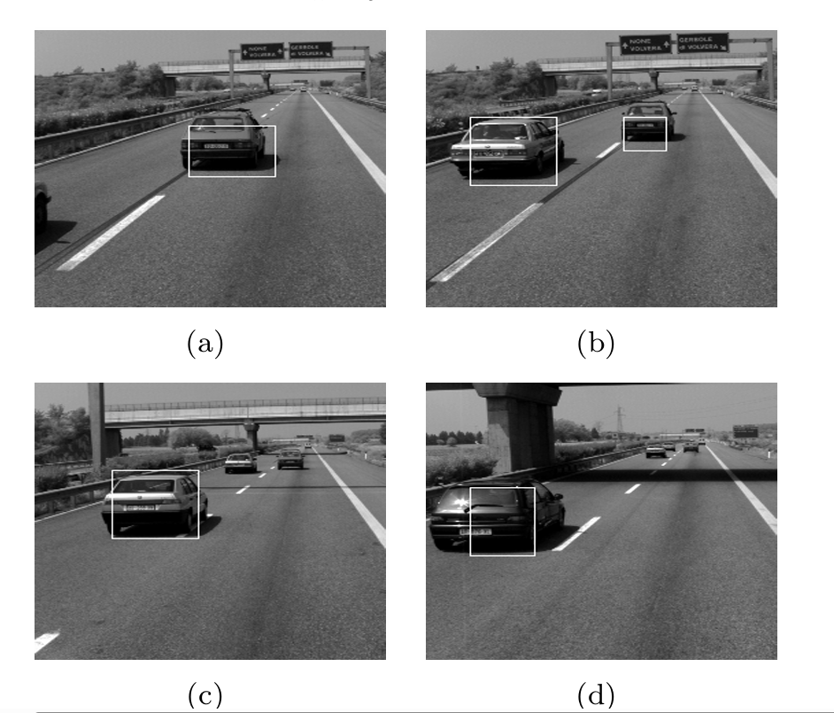
Example & Findings (Category 1) :
YOLO, classical motion analysis, and contour-based methods detect vehicles, people, obstacles.
Instance segmentation (CIICF + CDDM) improves object boundaries in crowded scenes.
Systems measure traffic volume, detect road jams, track vehicles, and predict dangerous motion.
Multimodal vision-language models identify objects and describe events (e.g., “car changing lane”).
This example of output taken from paper named - OBSTACLE DETECTION IN ROAD SCENE
BASED ON ROAD DETECTION AND MOTION
ANALYSIS
Obstacle detection on the highway

Slide 6
Conclusion & Implementation:
These methods help classify road conditions, lane structure, and scene types, and improve accuracy under poor weather. They strengthen overall situational awareness.
Add road-type recognition (normal / construction / roundabout / damaged).
Use lane detection + intersection detection for traffic rule analysis.
Use polarimetric augmentation to improve accuracy in bad weather video footage.
Integrate road-quality estimation to support safety and decision-making.
2
3

Slide 7
Category 2: ROAD SCENE UNDERSTANDING (Road Surface, Lane Counting, Road Type, Weather)
Key Insights and Findings:
Road surface detection
Scene recognition (normal road, construction, undeveloped, roundabout)
Poor-weather enhancement using polarimetric data
Lane counting & intersection detection
Road quality assessment
2
3

Slide 8
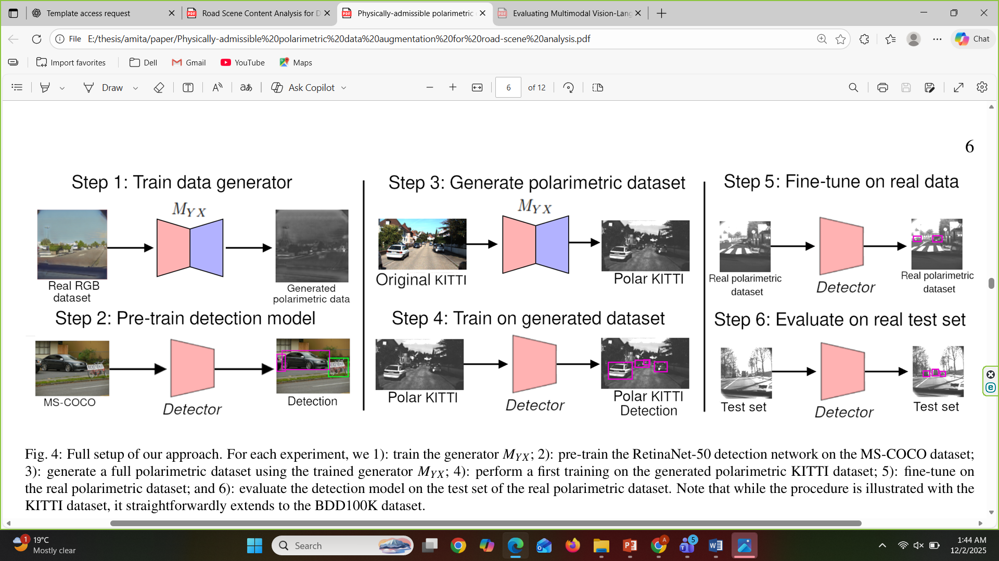
Example & Findings (Category 2) :
Models classify road scenes and identify markings, intersections, lane numbers.
Polarimetric augmentation increases detection accuracy in rain/fog/low light.
Vision-language models identify road conditions and scene types across 14,000 multimodal frames.
Full setup of our approach. For each experiment, we 1): train the generator MYX; 2): pre-train the RetinaNet-50 detection network on the MS-COCO dataset; 3): generate a full polarimetric dataset using the trained generator MYX; 4): perform a first training on the generated polarimetric KITTI dataset; 5): fine-tune on the real polarimetric dataset; and 6): evaluate the detection model on the test set of the real polarimetric dataset. Note that while the procedure is illustrated with the KITTI dataset, it straightforwardly extends to the BDD100K dataset.
This example of output taken from paper named - Physically-admissible polarimetric data augmentation for road-scene analysis

Slide 9
Conclusion & Implementation:
These methods help classify road conditions, lane structure, and scene types, and improve accuracy under poor weather. They strengthen overall situational awareness.
Add road-type recognition (normal / construction / roundabout / damaged).
Use lane detection + intersection detection for traffic rule analysis.
Use polarimetric augmentation to improve accuracy in bad weather video footage.
Integrate road-quality estimation to support safety and decision-making.
2
3

Slide 10
Category 3: TRAFFIC ANALYSIS & DENSITY ESTIMATION
Key Insights and Findings:
Traffic density classification
Traffic flow & congestion analysis
Measuring vehicle movement and jam formation
Digital-twin based traffic simulation
2
3

Slide 11
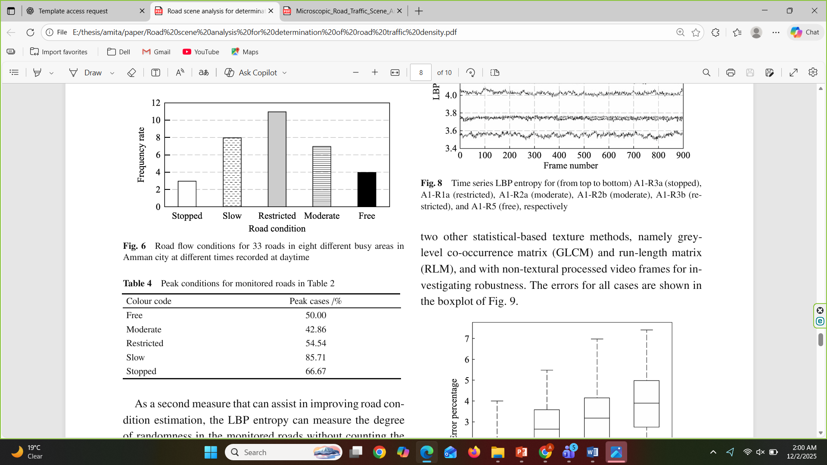
Example & Findings (Category 3) :
Road classified into 5 density levels (blue→red).
Models analyze traffic flow, jam buildup, and speed patterns.
Digital twin simulates mixed autonomous traffic to detect future safety hazards.
This example of output taken from paper named - Road scene analysis for determination of road trafficdensity

Slide 12
Integrate real-time vehicle motion tracking for density estimation.
Support traffic rule enforcement by checking crowded vs normal scenes.
Use traffic flow modeling for risk prediction.
Add digital-twin concepts for virtual testing before real deployment.
Conclusion & Implementation:
Traffic density and flow modeling improve understanding of congestion levels and vehicle movement patterns. Useful for analyzing jam build-up and risk situations.
Integrate real-time vehicle motion tracking for density estimation.
Support traffic rule enforcement by checking crowded vs normal scenes.
Use traffic flow modeling for risk prediction.
Add digital-twin concepts for virtual testing before real deployment.
2
3

Slide 13
Category 4 : CONNECTIVITY & IoV (Internet of Vehicles)
Key Insights and Findings:
IoV connection modeling
Connectivity quality metrics
Data forwarding / packet error / link stability
Communication issues in urban environments
Safety simulation using IoT + digital twins
2
3

Slide 14
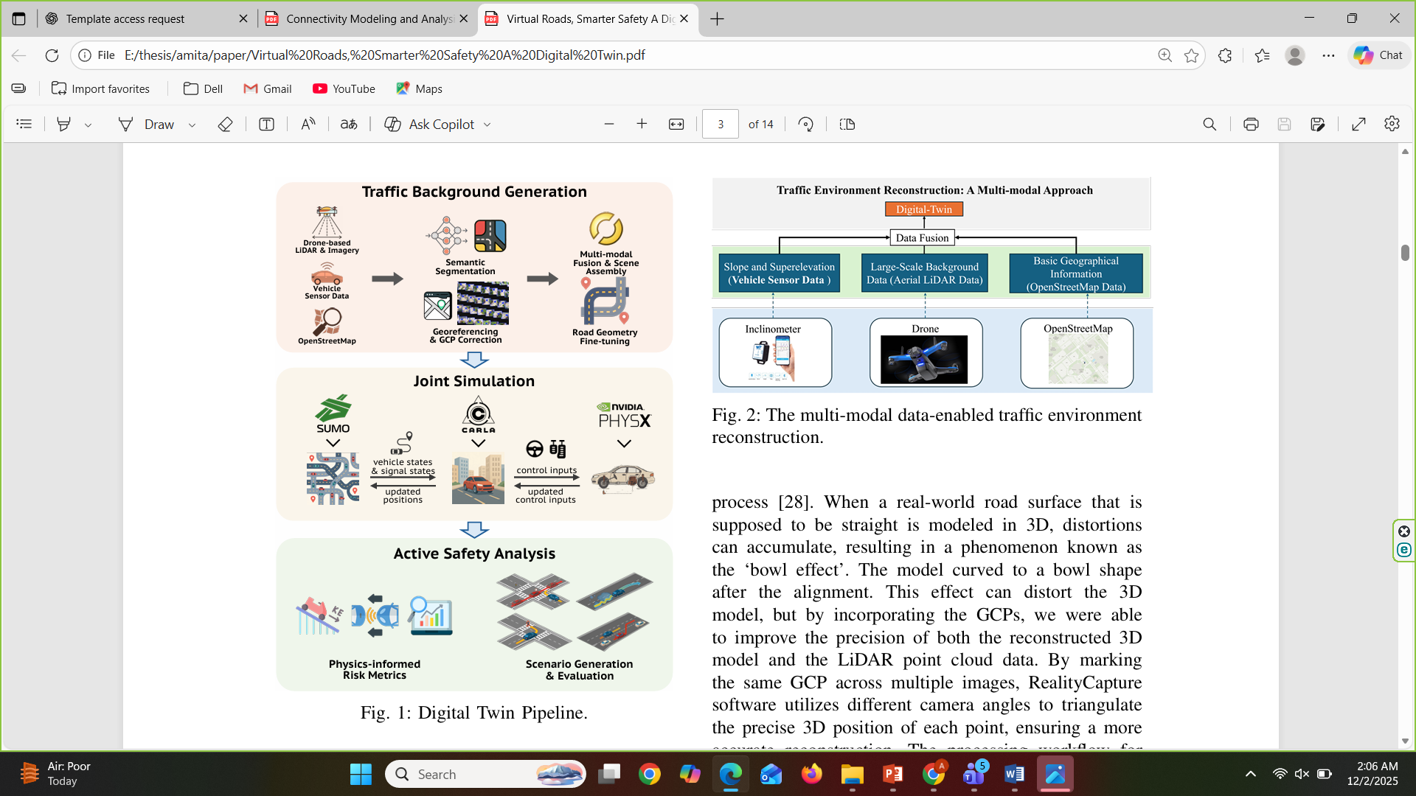
Example & Findings (Category 4) :
Identifies weaknesses in IoV connections (urban obstructions).
Analyzes 4 connectivity metrics to improve communication reliability.
Digital twin supports IoT-based safety evaluation and risk prediction.
This model example taken from paper named - Virtual Roads, Smarter Safety: A Digital Twin Framework for Mixed Autonomous Traffic Safety Analysis
Digital Twin Pipeline.

Slide 15
Conclusion & Implementation:
Connectivity modeling ensures stable communication in urban environments, while digital-twin simulation predicts risks before they happen. Enhances reliability and safety.
Use IoT connectivity insights for real-time communication between camera units / servers.
Integrate digital-twin connectivity for fail-safe alerts and remote monitoring.
Improve system reliability for traffic rule violation detection in urban settings.
2
3

Slide 16
THANK
YOU
PREMIERE UNIVERSITY

